Slide 1

Forecasting Social Media Activity by Location
Machine Learning for Industrial Data
Vysotskiy Roman Valerevich, J4232c Vershinin Vladislav, J4233c Kozlyak Ruslan, J4232c
St. Petersburg 2024

Slide 2
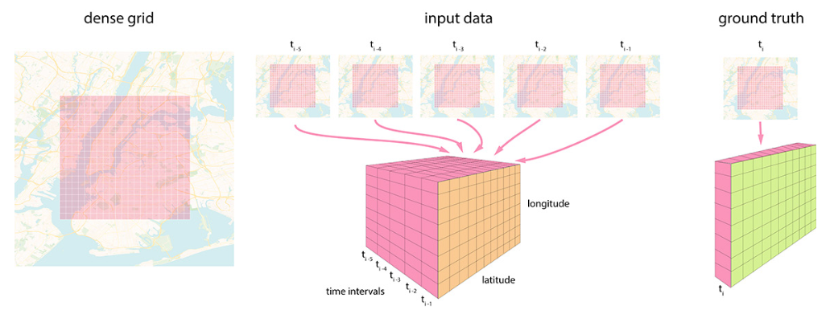
Context of the task
2
Notes:
Here you can see the content of my speecOn this slide, you can see the context of the task. We have spatiotemporal data on posts made at different times in different places. The space is divided by a grid into squares of 250 meters. In each of them, several posts may occur at a time, or there may be no posts at all
h and presentation

Slide 3
Meta-data
lon, lat – geoposition coordinates rounded up to a 250x250 meter polygon
timestamp – timestamp of the publication accurate to one hour
likescount – number of "likes" in the publication
commentscount – number of comments of the publication
symbols_cnt – number of all symbols in the publication
words_cnt – number of words (without special characters and other meta-information)
hashtags_cnt – number of hashtags
mentions_cnt – the number of mentions of other users
links_cnt – number of links
emoji_cnt – number of emoji
point – service field
3
Notes:
Each publication is described by the following meta-information:
point – service field for matching coordinates from training, validation and test datasets (if two elements have the same point, they have the same coordinates, comparison of lat and lon may give an error)
Each publication is described by the following meta-information:
point – service field for matching coordinates from training, validation and test datasets (if two elements have the same point, they have the same coordinates, comparison of lat and lon may give an error)

Slide 4
Useful information about data
The raw train data contains the following information:
8.5 million records
12 features
Hourly data (from 01.01.2019 00:00 to 31.01.2020 23:00)
7041 unique cubes/points
4
Notes:
The dataset consists of 8.5 million records of posts made in almost 2 years. Posts were made in 7041 cubes. But this is only part of the proposed grid. There are more cubes in the grid itself.

Slide 5
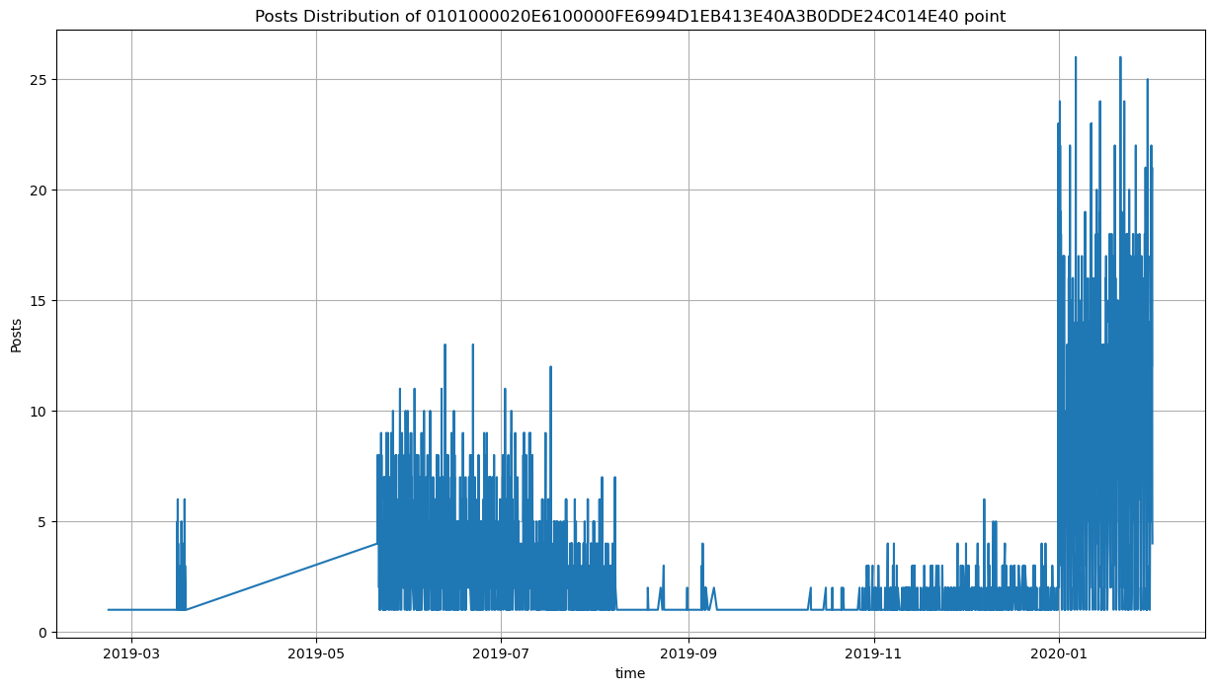
Example of point data
5
Notes:
As we can see, some point/cubes do not full range from 01.01.2019 00:00 to 31.01.2020 23:00, that might cause problems with model training.
On the first view it seems to -be obvious to add missing data, like people didn’t post anything. However this decision will lead to enormous increasing data observations.
As we can see, some point/cubes do not full range from 01.01.2019 00:00 to 31.01.2020 23:00, that might cause problems with model training.
On the first view it seems to -be obvious to add missing data, like people didn’t post anything. However this decision will lead to enormous increasing data observations.
If you take all the cubes and all the clocks in two years and try to compile complete clock data, you will get about 70 million records. Most of which will be zero, but they will fill the data gap between posts, the lack of records may also be important, but it is not advisable to process such a volume of information.

Slide 6
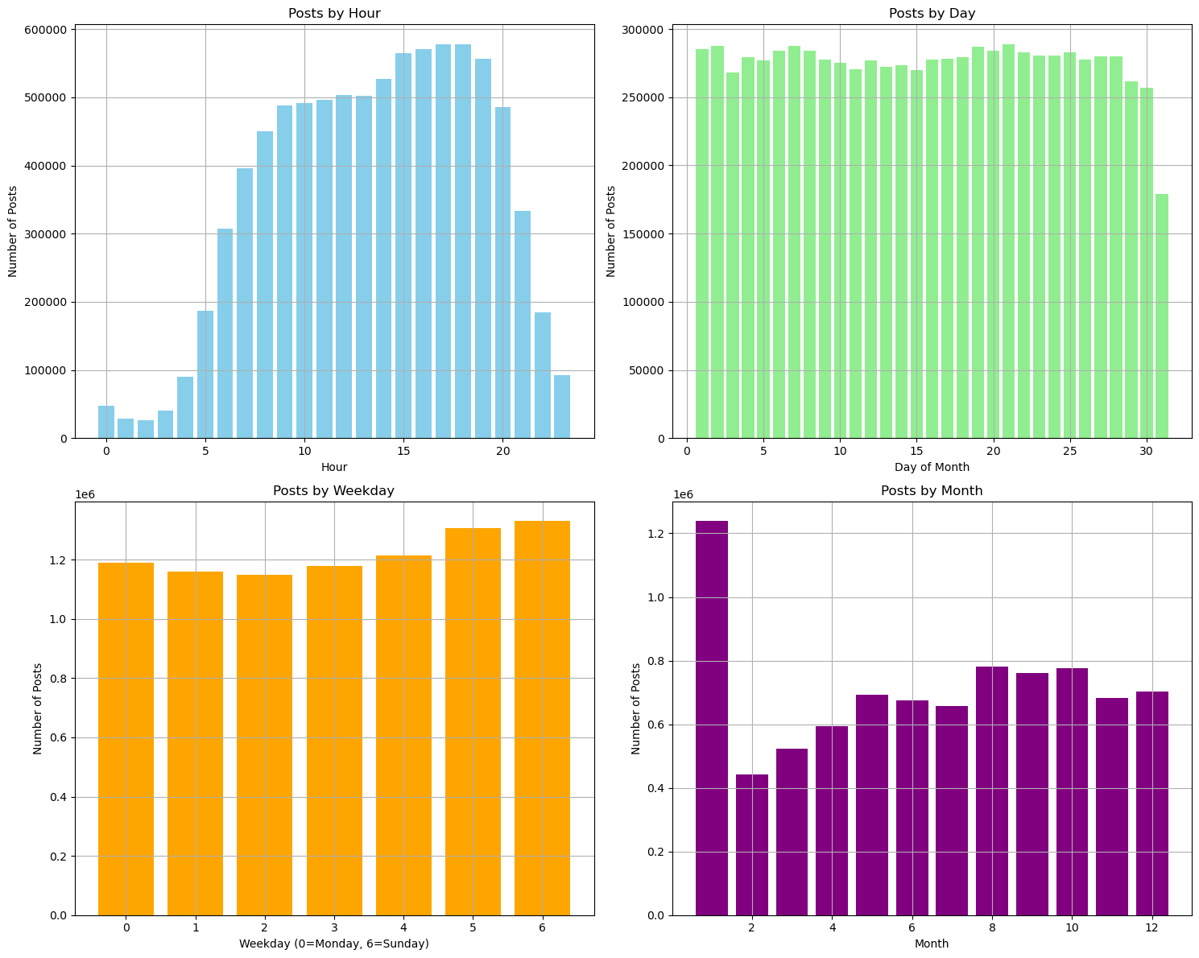
Posts distribution by diff time format
By Hour: Peaks at 4-5 PM, lowest at night.
By Day: Even, slight drop at month's end.
By Weekday: Highest on weekends, lowest on Wednesday.
By Month: Peak in January, stabilizes from March.
6
Notes:
Posts by Hour:
The number of posts is minimal during the night (0-5 hours).
A sharp increase starts at 6 AM, peaking between 4 and 5 PM.
After 5 PM, activity gradually declines.
Posts by Day of Month:
Posts are evenly distributed throughout the month.
A slight decrease in activity is observed towards the end of the month.
Posts by Weekday:
User activity is lowest on Wednesday
Activity steadily increases through the week, peaking on Saturday and Sunday (5th and 6th days of the week).
Posts by Month:
January shows the highest number of posts.
Starting in February, user activity declines and stabilizes from March through December.

Slide 7
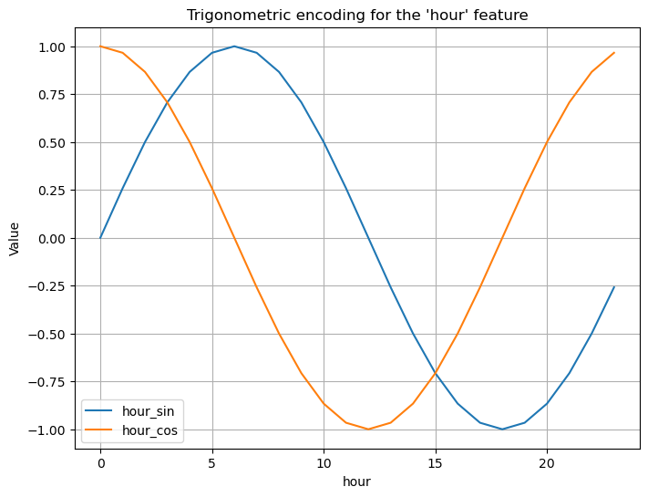
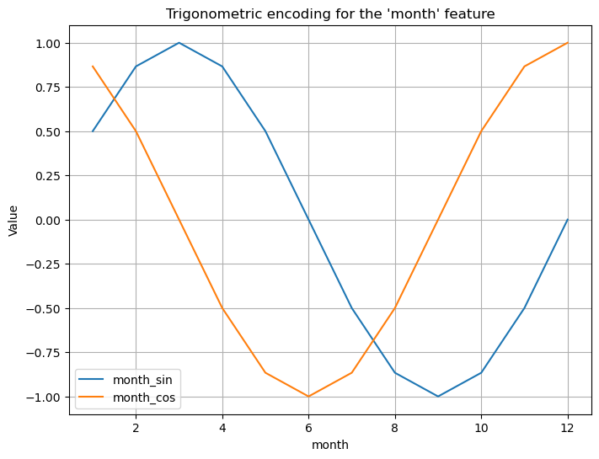
Adding statistics to points
For purpose to help model distinguish time correctly (that 30/31 day close to the end of month e.t.c.) we change hour/day/day of week/month to the cos sin functions for each time format.
As each point (cube) can have different distribution, we add next statistics for them:
Mean
Standart Deviation (std)
mean_hour_sin
mean_hour_cos
mean_weekday_sin
mean_weekday_cos
mean_month_sin
mean_month_cos
7

Slide 8
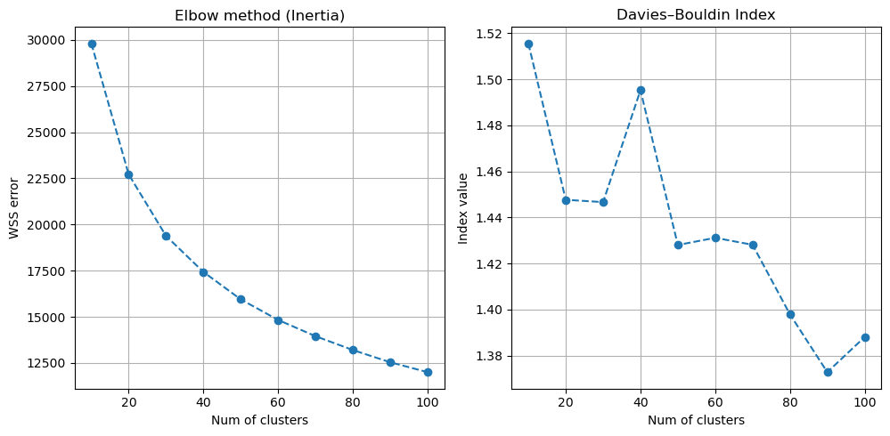
Clusterization
8
Notes:
We took K-means method as its simple and easy interpretable dividing method.
Also this method do not take so much time for clusterization, and we can change the number of desirable classes, as DBSCAN that could find enormous number of clusters.
In advantage of K-means we can estimate what exactly amount of clusters better to choose.

Slide 9
Clusterization
9
Notes:
We decided to take 50 cluster. It’s not a small number and not so big. Moreover, we see that at 50 clusters Davies-Bouldin Index dump after rocket increase. An uncertain situation with Elbow method, after 30 clusters WSS error goes down slowly, we cannot see ‘Elbow’, so 50 clusters look good.

Slide 10
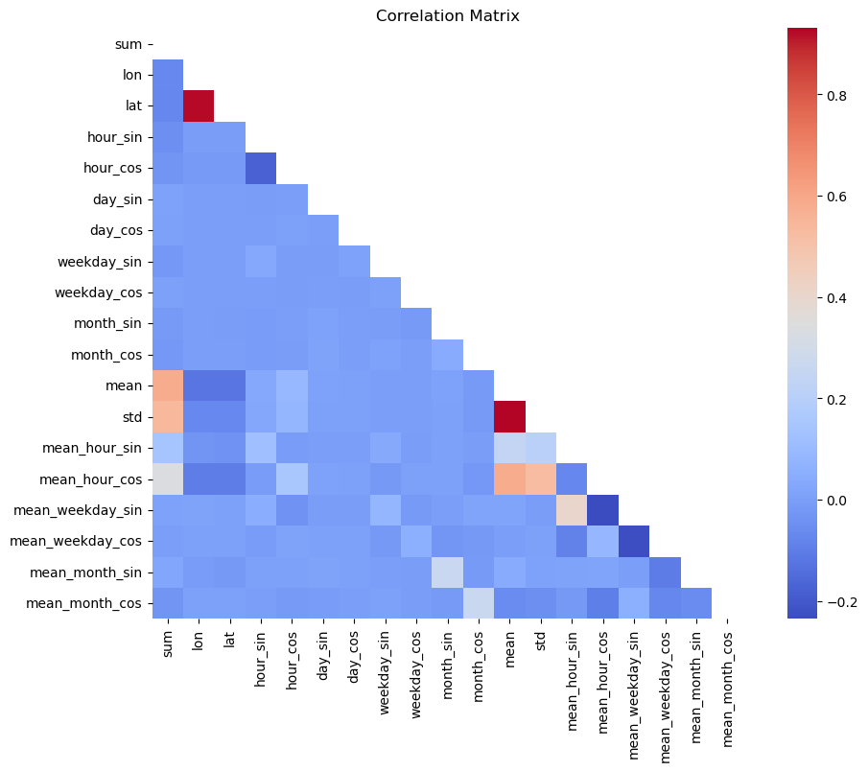
Correlation matrix
Lat and lon have strong correlation
Mean and std have strong correlation
Mean_weekday_sin and mean_hour_cos as their inverse function have negative small correlation
10
Notes:
The slide presents a correlation matrix illustrating relationships between various features. Key insights include a strong correlation between latitude (lat) and longitude (lon), as well as between mean and std. Additionally, mean_weekday_sin and mean_hour_cos exhibit a small negative correlation due to their inverse relationship. These observations provide insight into how features relate to each other, which can impact their utility in predictive models.
The current feature set is insufficient for the model to establish meaningful connections between features and the target variable. To address this, we applied the polynomial features method. This approach generates a new feature matrix that includes all polynomial combinations of features up to a specified degree. For example, given an input [a, b], degree-2 polynomial features include [1, a, b, a^2, ab, b^2] (source: scikit-learn documentation).
In our case, we focused solely on interaction features—terms formed by the product of distinct input features. Terms involving higher powers of the same feature (e.g., x[0]2x[0]2 or x[0]2⋅x[1]x[0]2⋅x[1]) were excluded to avoid redundancy.
After completing feature engineering, we expanded the dataset to 172 features and 3.6 million rows, enhancing the model's ability to capture complex interactions.

Slide 11
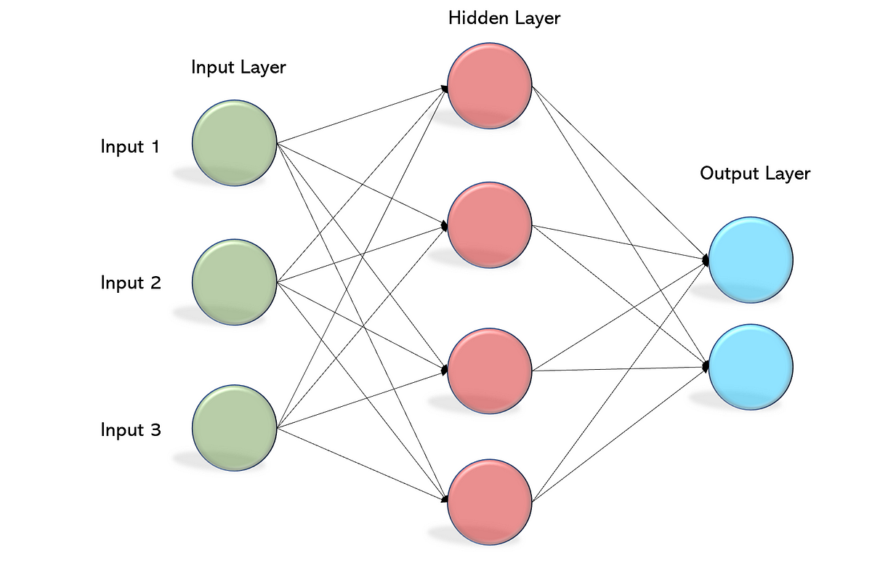
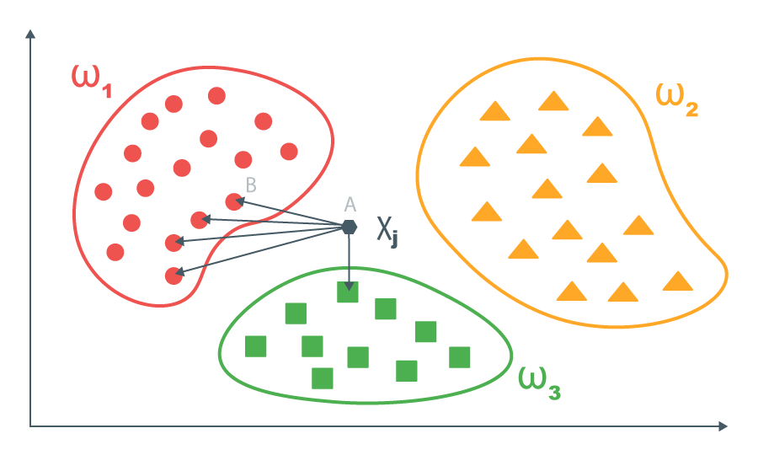
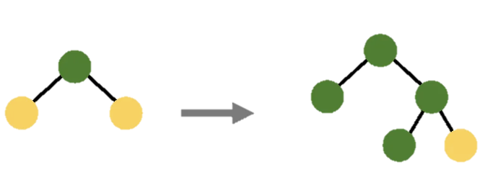
Chosen Models
Classic
Gradient Boost
Neural
KNeighbors:
Good for an initial understanding of the data structure and tasks with small sets.
HistGradientBoosting,
LightGBM,
CatBoost:
An excellent choice for large tabular data.
Multi-layer Perceptron(MLP):
More complex model capable of handling nonlinear dependencies.
11
Notes:
We included a diverse set of models to ensure a well-rounded comparison and to leverage their different strengths:
KNeighbors acted as a fundamental, non-parametric reference point that focuses on local patterns instead of overarching trends, enabling us to gauge the extent to which more sophisticated techniques surpass a rudimentary method;
HistGradientBoosting, renowned for its adept histogram-based splits, delivered impressive baseline performance while adeptly managing extensive datasets;
LGBM, celebrated for its gradient-driven one-side sampling and leaf-wise partitioning, infused both swiftness and adaptability into the management of intricate features;
CatBoost, with its innovative ordered boosting and intrinsic categorical processing, frequently attained resilient performance across demanding datasets and facilitated a clearer understanding of feature significance;
and at last, the MLP, embodying a neural network paradigm, thrived in capturing nonlinear dynamics and nuanced patterns that other models might overlook, ultimately providing the most substantial enhancement once we enriched our features.

Slide 12
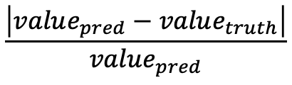
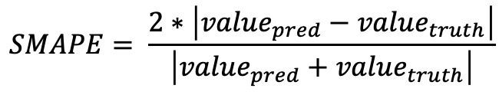
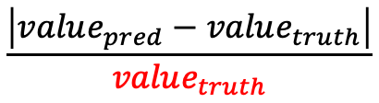
Error function
The offered error function has several disadvantages:
The error depends on the predicted value (value_{pred}), not the ground truth (value_{truth});
Small predicted values can lead to exaggerated errors, even for minor differences (in case value_{truth} are in the big range like 1 to 1000;
Large predicted values can result in artificially low error values, misrepresenting the actual quality, this disadvantage is connected with first one.
What we can do:
Use value_{truth} as denominator
Use other metrics like – SMAPE, RMSE, MSE …
$$\frac{\left|value_{pred}−value_{truth}\right|}{value_{pred}}$$
$$\frac{\left|value_{pred}−value_{truth}\right|}{value_{truth}}$$
$$SMAPE= \frac{2∗\left|value_{pred}−value_{truth}\right|}{\left|value_{pred}+value_{truth}\right|}$$
12
Notes:
The error depends on the magnitude of the predicted value (value_pred), and not on the true value (value_truth);
The formula does not work well when comparing values with different scales (for example, if the true values range from 1 to 1000). In such cases, most of the errors will be artificially inflated due to division by prediction_value.
If the predicted value is significantly less than the true value (prediction_value≪ground_truth_value), then the error can be huge, even if the deviation is small.
“At first, we used an error metric that depended on the model’s prediction rather than the true value. This caused unfair results. For example, if the model greatly underestimated the true number of posts, even a small absolute difference looked like a very large error. Also, when comparing values that vary a lot in scale (like some values near 1 and others near 1000), the original metric became misleading. To fix this, we switched to more standard and stable metrics such as RMSE, MAPE, and SMAPE. These metrics are less sensitive to unusual predictions and give a clearer sense of how well the model fits the real data.”

Slide 13
Model Comparison
Model | Сustom metric | RMSE | MAPE | SMAPE
HistGradientBoosting | 0.95 67% | 7.07 9.7% | 0.40 25.9% | 0.53 30.3%
KNeighbors | 1.00 116% | 6.97 21.1% | 0.42 28.8% | 0.56 35.6%
LGBM | 1.07 50% | 7.65 2.9% | 0.43 20.4% | 0.57 25.0%
CatBoost | 0.96 -inf | 7.09 0.3% | 0.40 16.7% | 0.54 16.9%
MLP | 0.95 245% | 6.95 28.7% | 0.39 42.6% | 0.52 51.4%
Feature engineering significantly improved model quality:
RMSE reduced by 20%, MAPE by 25%, and SMAPE by 30% on average.
Key Achievements:
MLP showed the best enhancement in SMAPE (51.4%) and RMSE (28.7%).
13
Notes:
“After choosing better error metrics and adding more features, we compared several models: HistGradientBoosting, KNeighbors, LightGBM, CatBoost, and a Multi-Layer Perceptron (MLP). With RMSE, MAPE, and SMAPE, we saw strong improvements over our earlier results. For example, RMSE improved by around 20%, MAPE by about 25%, and SMAPE by roughly 30%. The MLP model stood out as a top performer, showing that a flexible model can capture patterns that simpler methods might miss. This progress shows how important it is to pick the right metrics and to carefully design our features.”

Slide 14
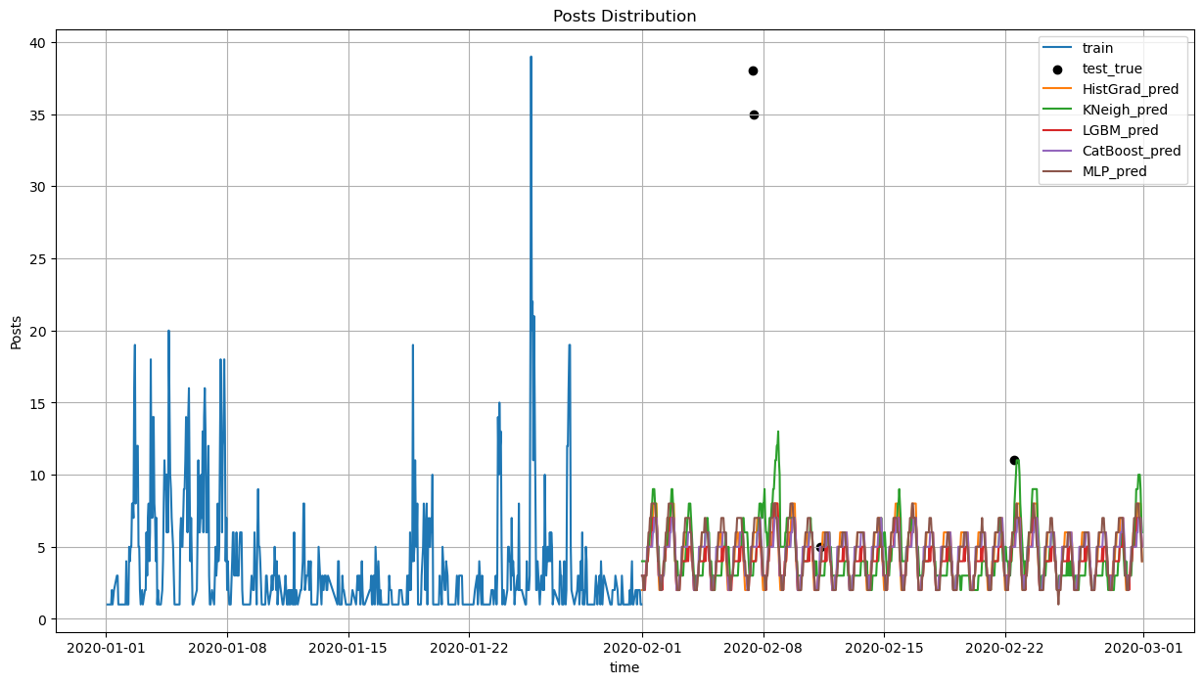
Models prediction
14
Notes:
“Here we show how different models predict the time series compared to the real data. The original data is shown as a reference line, and each model’s forecast is drawn over it.”

Slide 15
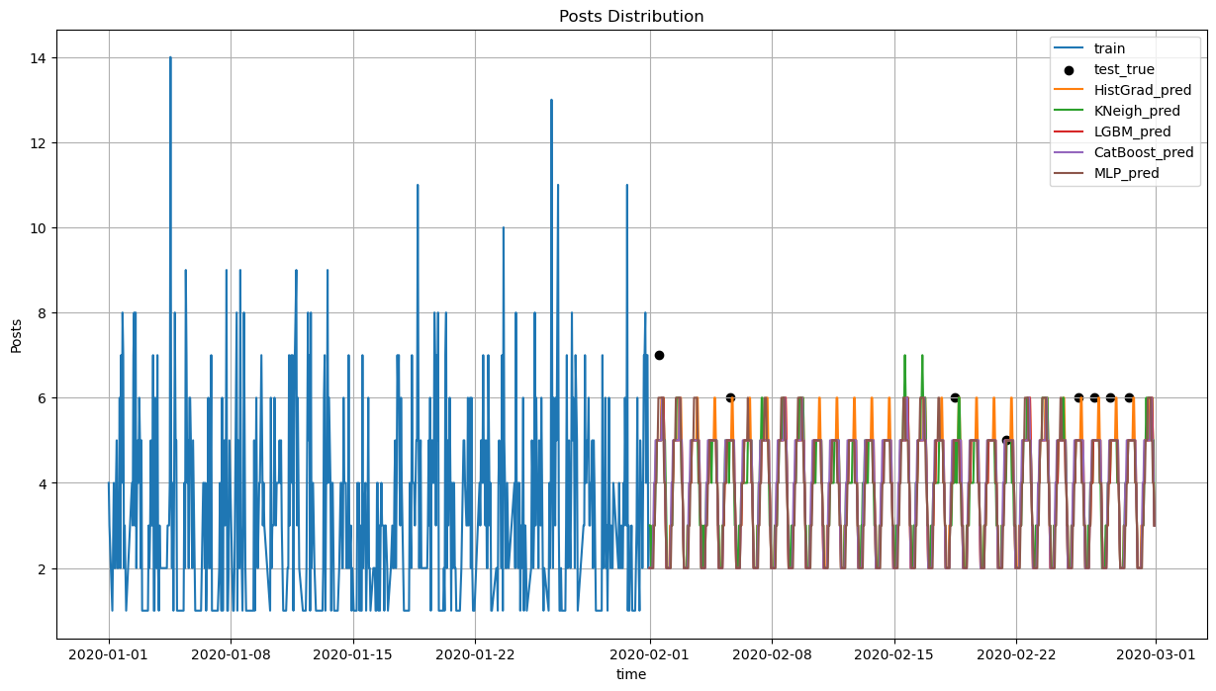
Models prediction
15
Notes:
“The MLP and some gradient boosting models (like CatBoost and LightGBM) closely follow the natural ups and downs of user activity. They are good at finding daily and weekly patterns and adjusting to changes in volume.”

Slide 16
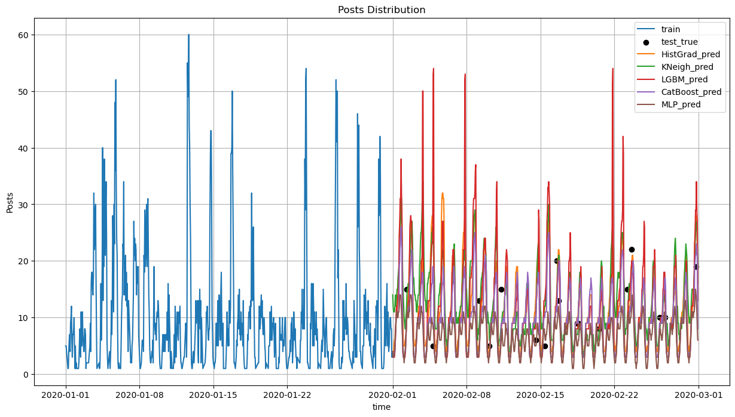
Models prediction
16
Notes:
“In contrast, simpler models like KNeighbors produce smoother forecasts that often miss sudden increases or drops in posting activity. By comparing these forecasts, we can see which models handle complex patterns better. This also reminds us that careful model selection and good features can lead to more accurate predictions.”

Slide 17
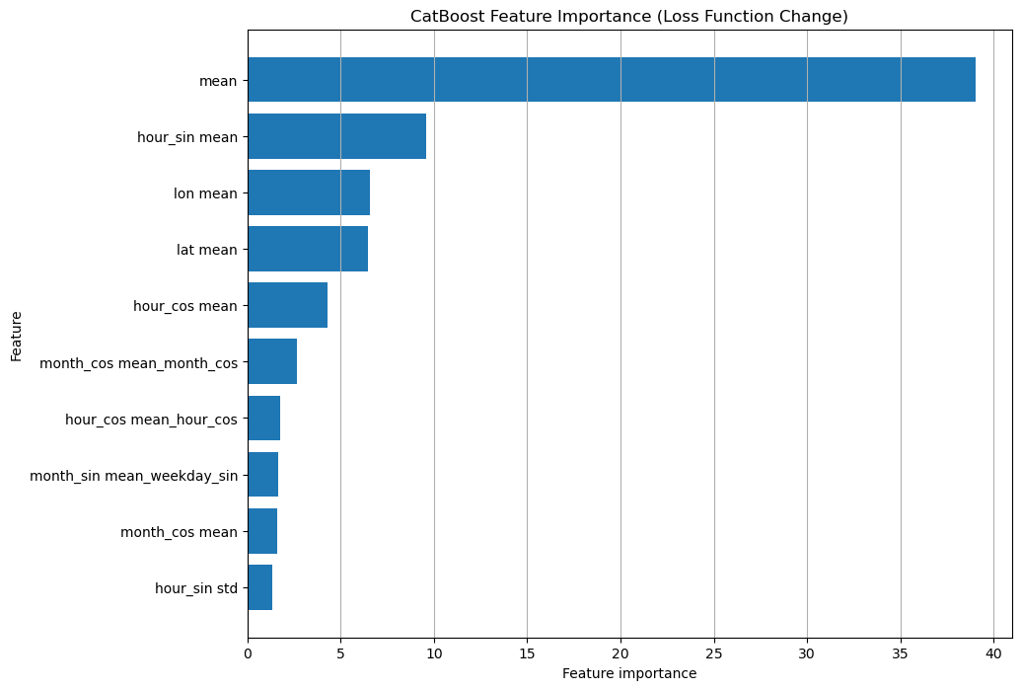
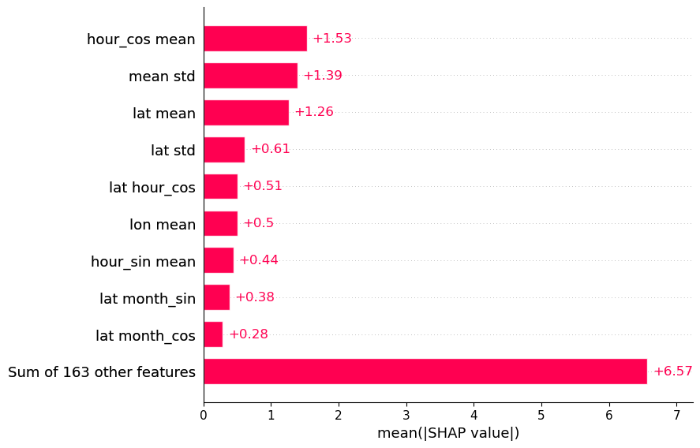
Feature Importance
17
Notes:
“To understand why certain models do better, we looked at feature importance using CatBoost and tools like SHAP values. This helps us see which features matter most for the final predictions.”

Slide 18
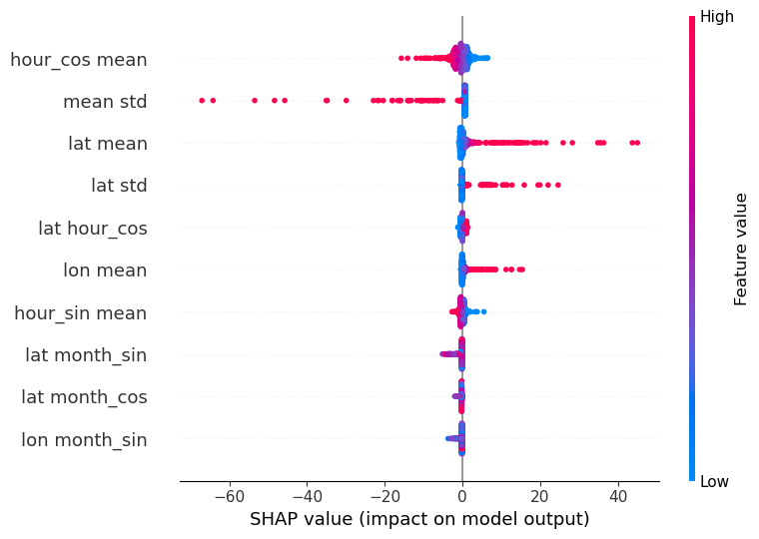
Summary plot by features
18
Notes:
“Key findings include time-based features like hour_sin and hour_cos, which help the model recognize daily cycles; statistical features that show general activity levels; and location features derived from latitude and longitude. Knowing which features the model relies on makes our approach more transparent and guides future improvements.”

Slide 19
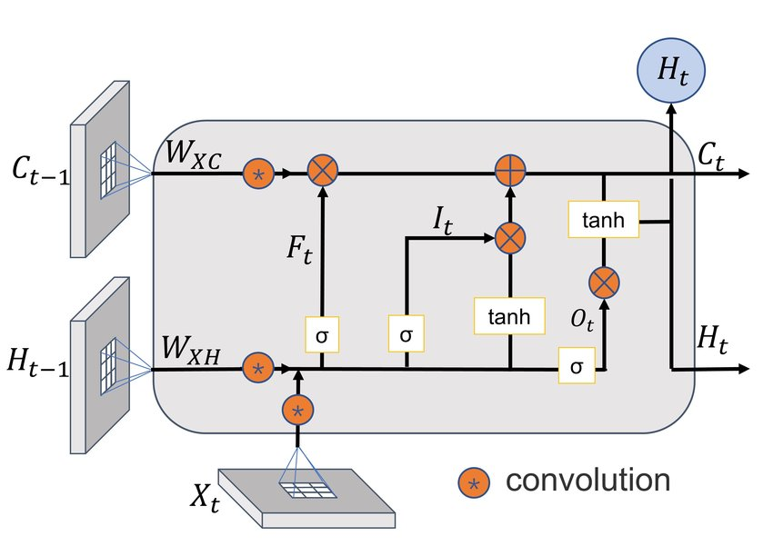
Attempt - Temporal GNN
Advantages:
The graph structure is taken into account;
It also allows you to take into account the time aspect of the data
Disadvantages:
The graph must contain the same number of nodes at each step, which makes the data sparse
Computational complexity
Prediction on a large horizon accumulates error
19
Notes:
Also, as a test solution, it is worth noting the Spatio Temporal GNN. Using this approach seemed natural within the scope of the task. GN can capture spatial dependencies, and GConvLSTM can work with time series. But the approach has drawbacks. To teach, the data must have the same size at each step, for this you need to fill in the missing data with zeros, which reduces the sparsity of the data and complicates learning. Also, due to the computational complexity and occupied memory, it is not possible to predict many steps into the future, and predicting a small number of steps leads to a rapid accumulation of errors in predictions. Therefore, it was decided to abandon this approach in favor of more lightweight and accurate solutions. Error on test 2000

Slide 20
Forecasting Social Media Activity by Location
Machine Learning for Industrial Data
Vysotskiy Roman Valerevich, J4232c Vershinin Vladislav, J4233c Kozlyak Ruslan, J4232c
St. Petersburg 2024

